Slide 1

Modelling Biomolecular Systems in Atomic Detail
Dr. Martin Stroet
Prof. Alan Mark
School of Chemistry and Molecular Biosciences
University of Queensland

Slide 2
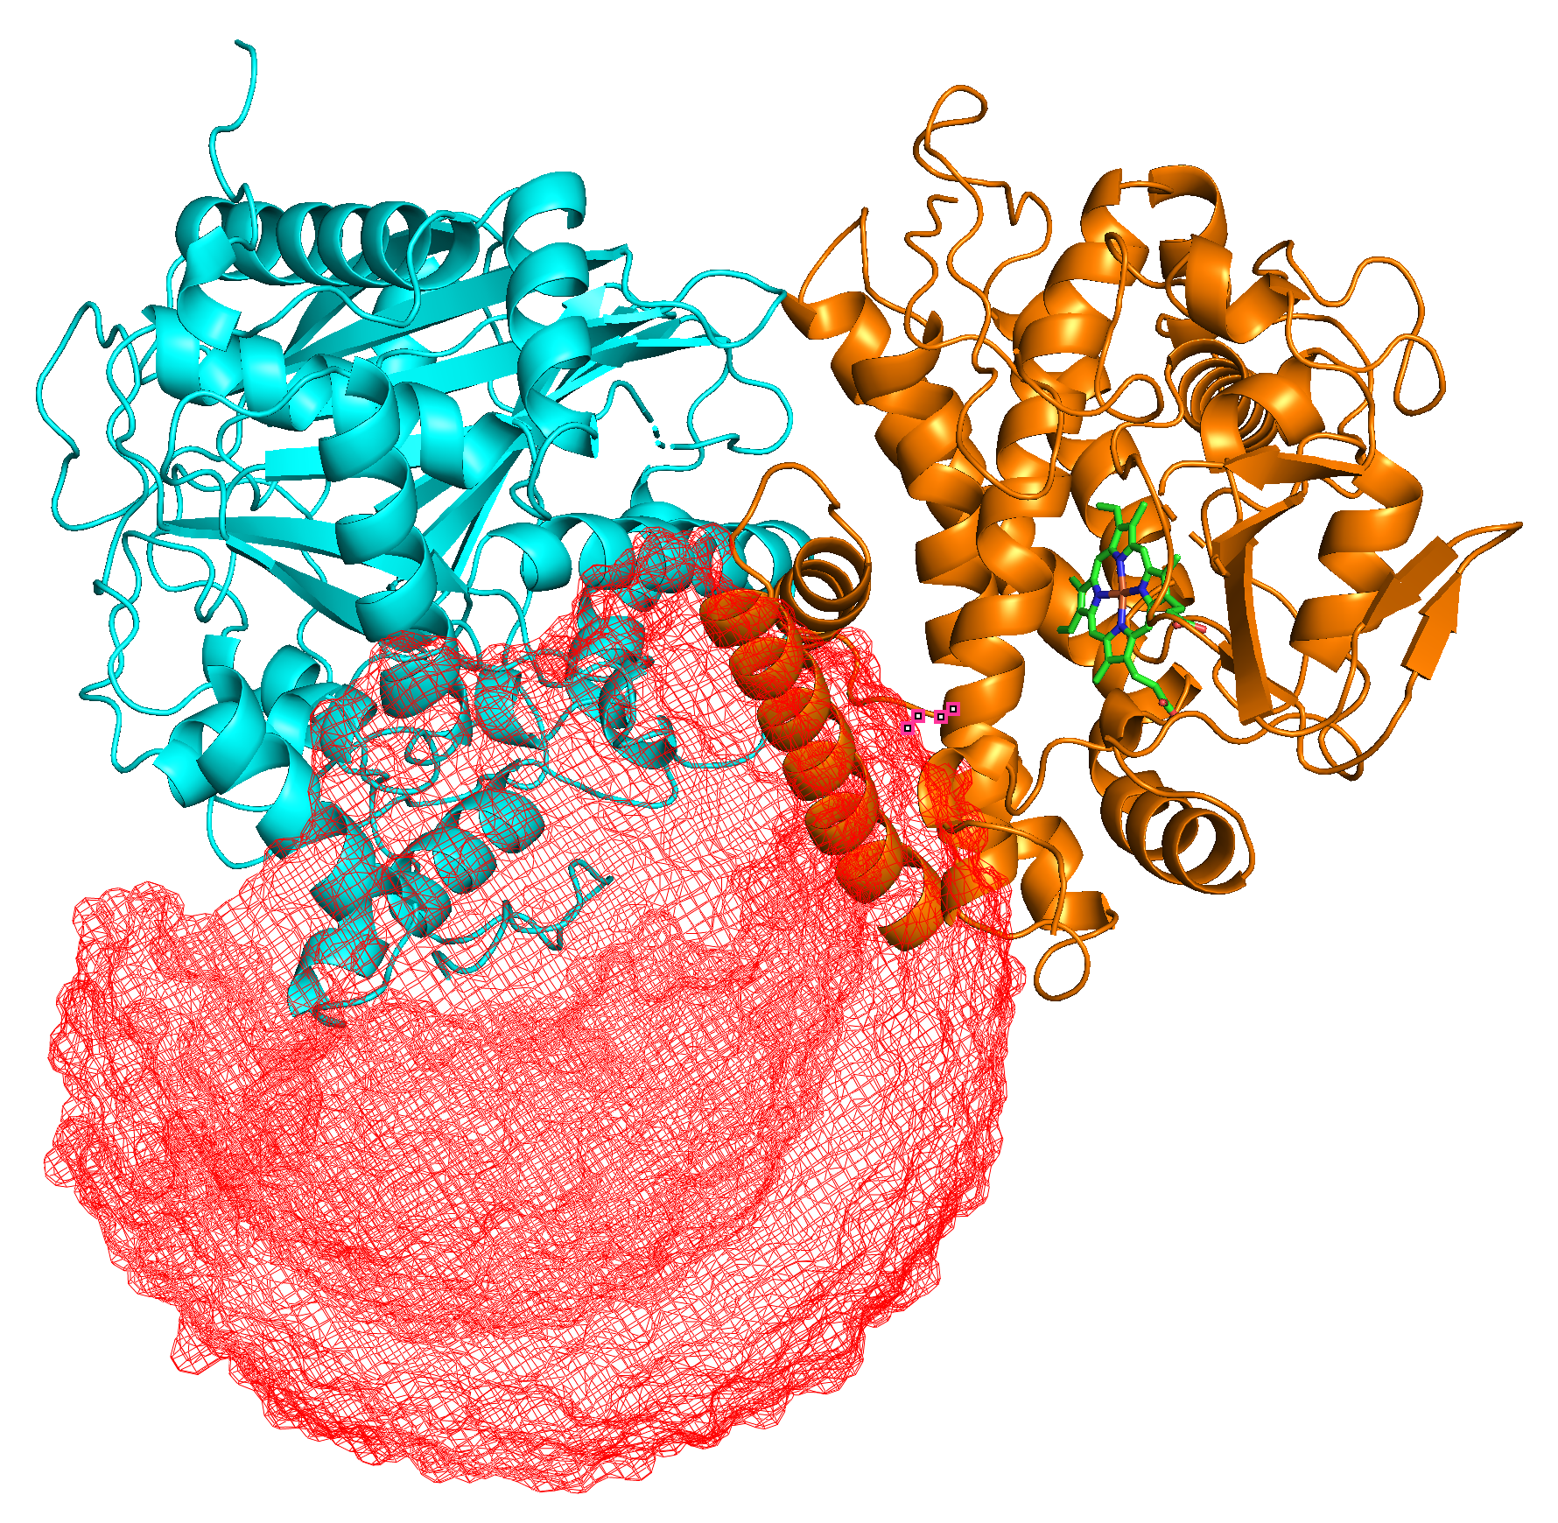
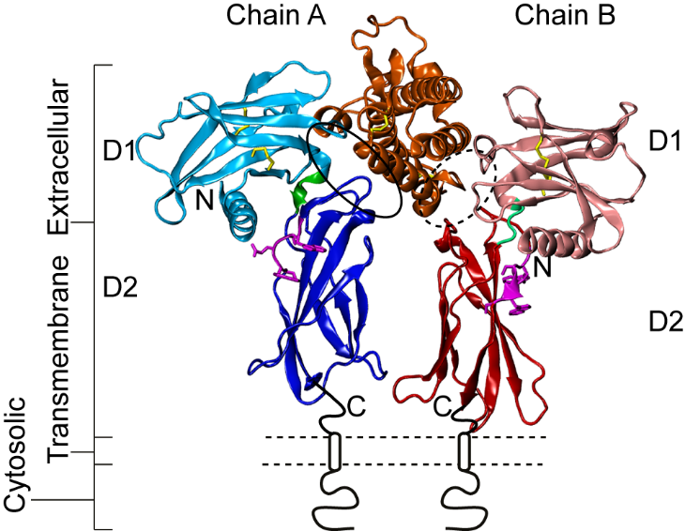
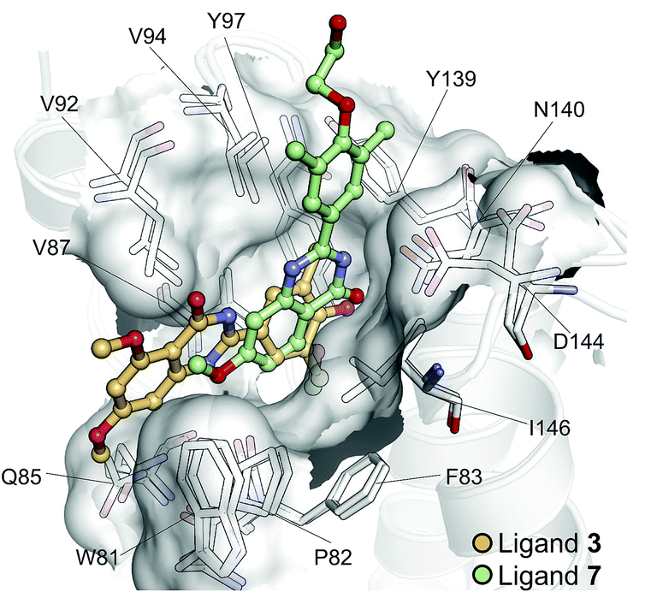
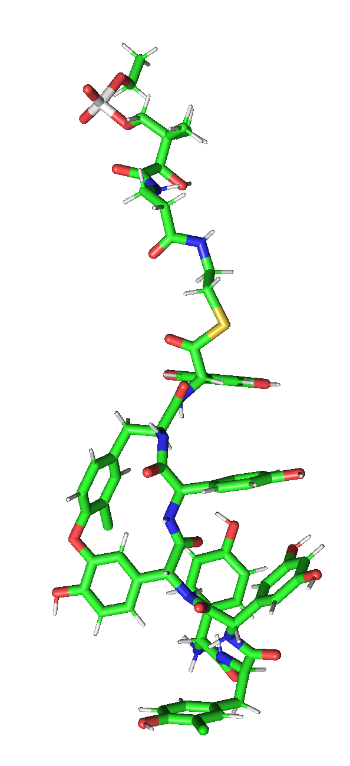
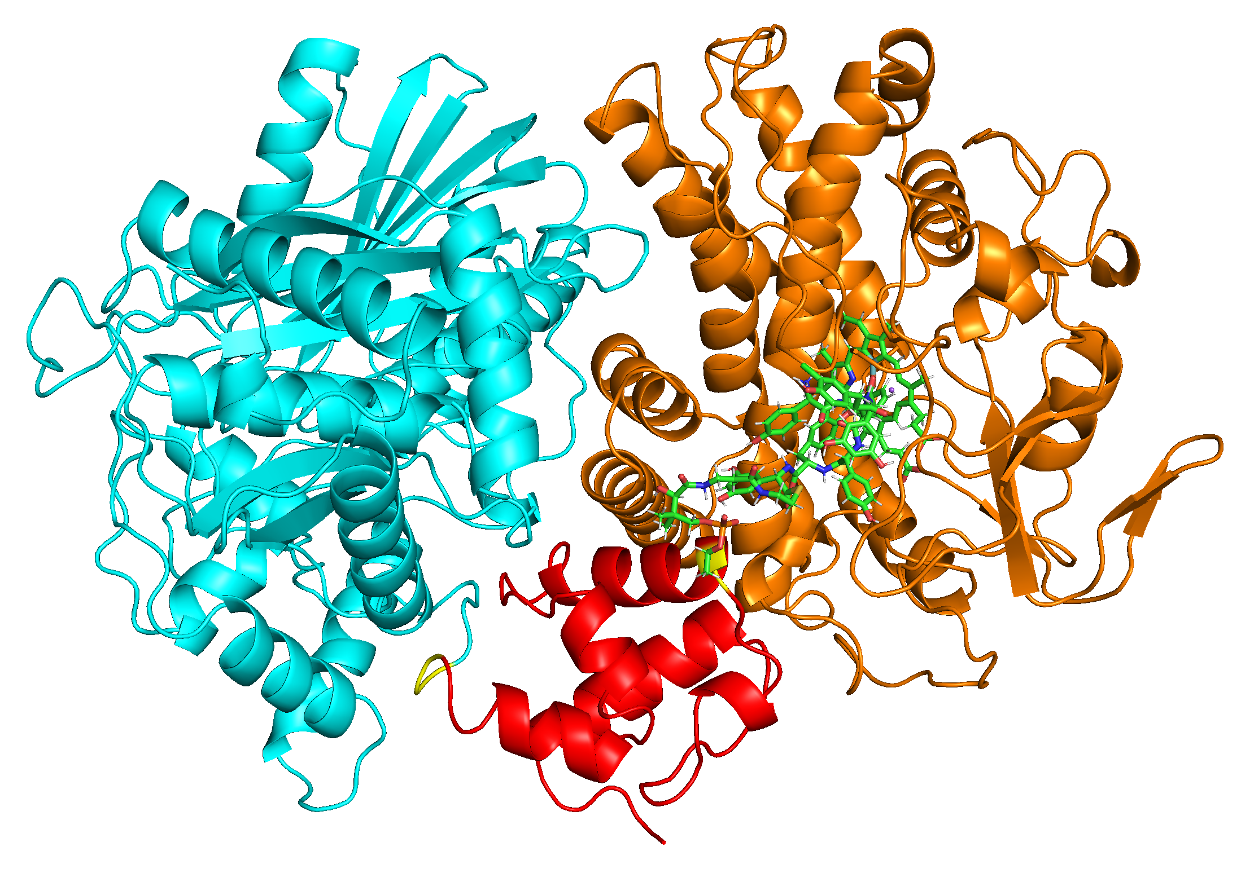
Biomolecular Modelling
Protein Structure and Dynamics
Membrane Signaling
Ligand-Protein Interaction
Glycopeptide Biosynthesis
Growth hormone
Structure-Based Drug Design
EPO
Molecular systems on the scale of:
1,000 to 1,000,000 atoms
nano (10⁻⁹) to milli (10⁻³) seconds
Newtonian mechanics
Empirical potentials

Slide 3
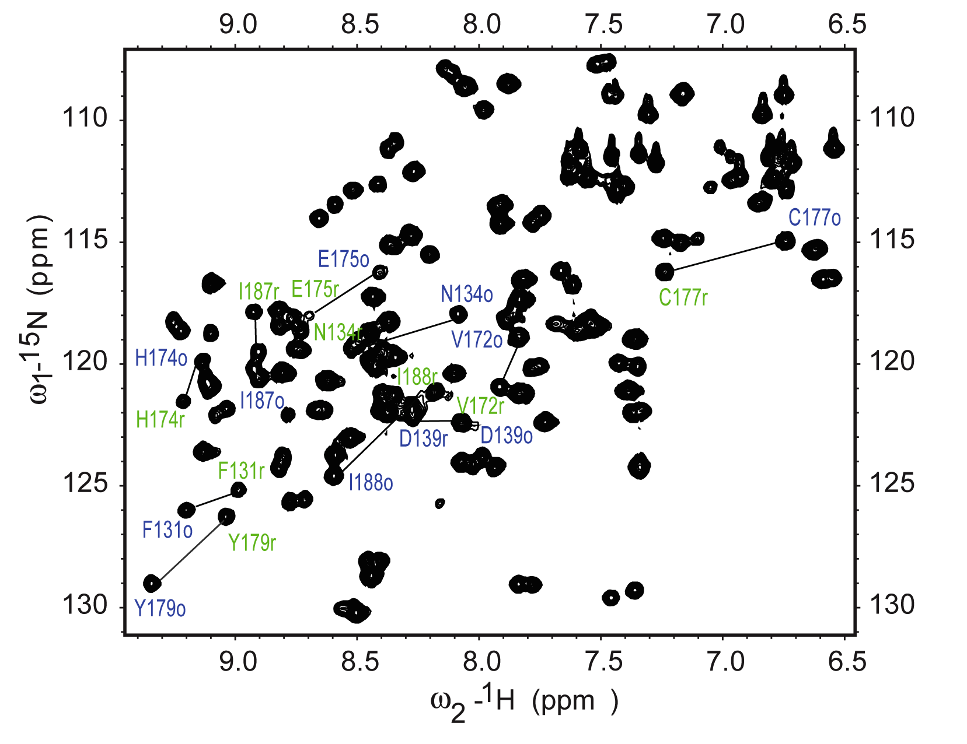
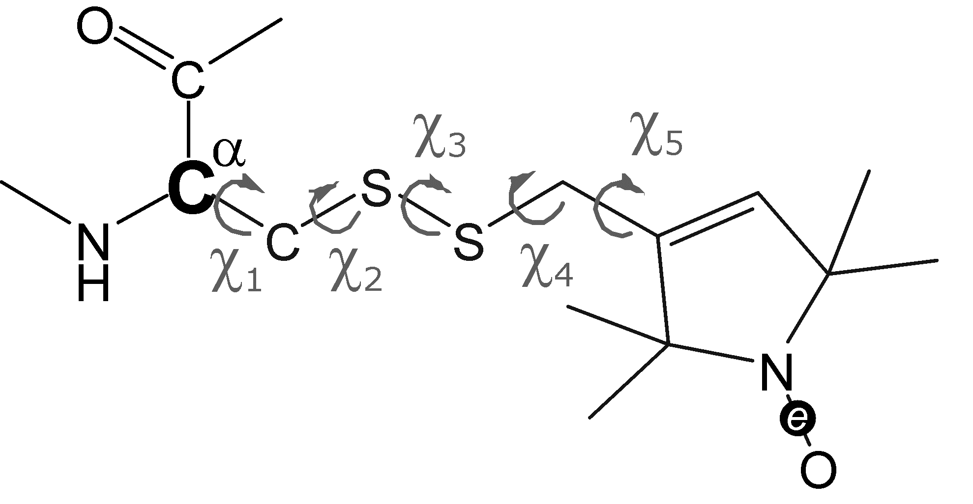
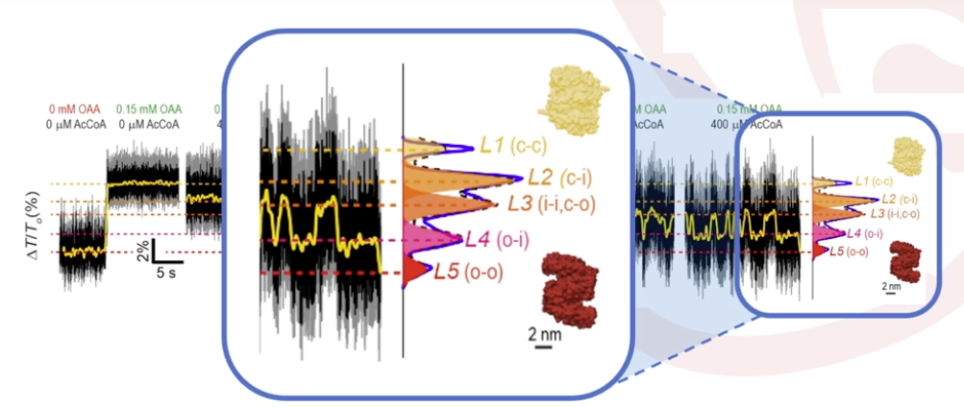
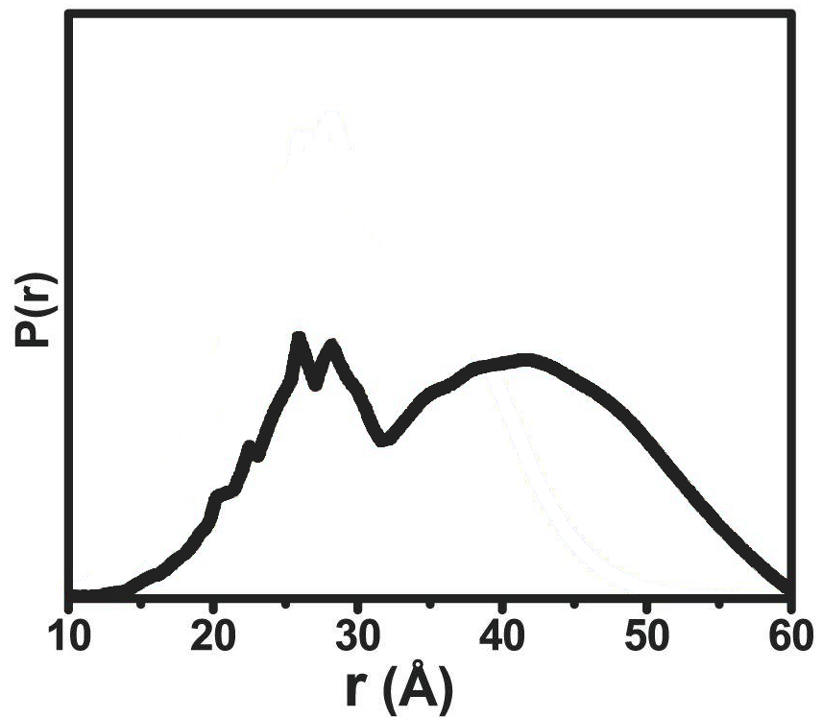
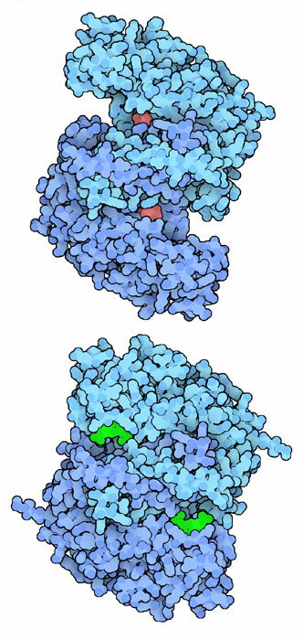
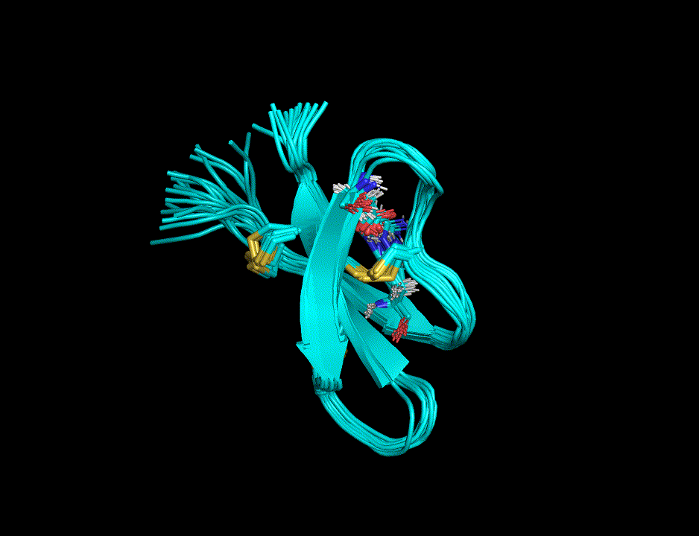
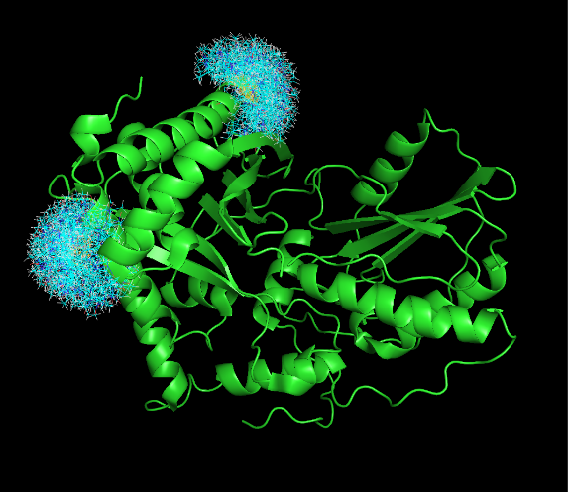
Nuclear Magnetic Resonance
(NMR) Spectroscopy
Electron Paramagnetic Resonance
(EPR) Spectroscopy
Optical Cavity Measurements

Slide 4
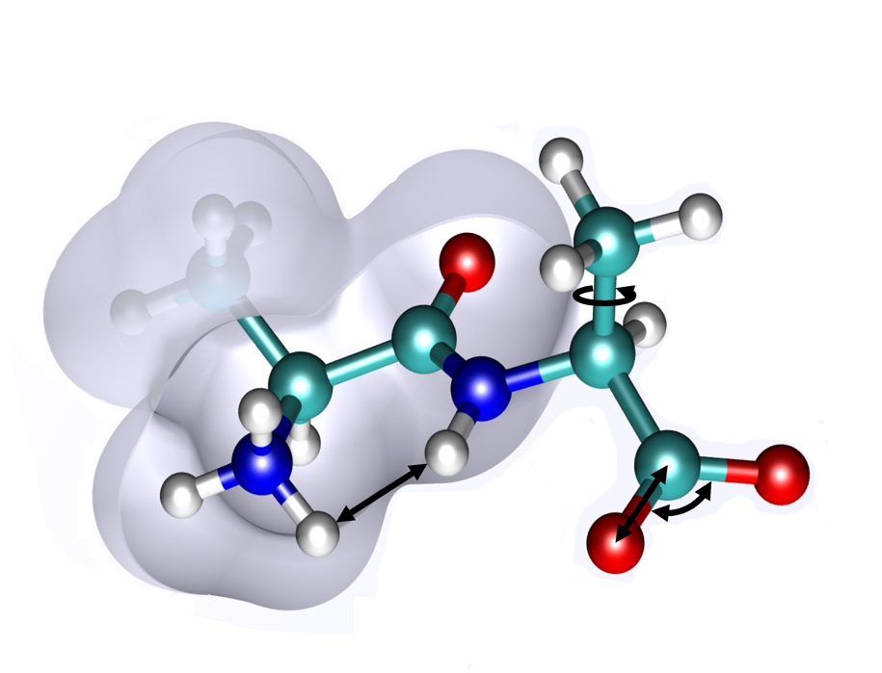
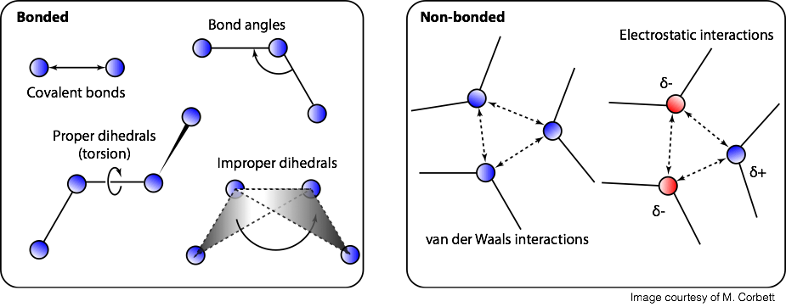
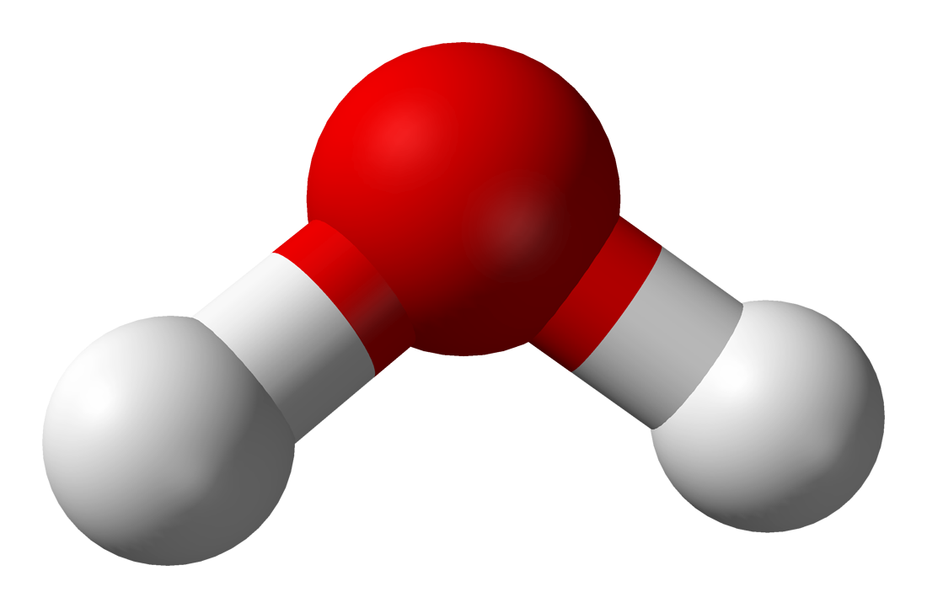
Empirical Molecular Models: Force Fields
39 Parameters

Slide 5
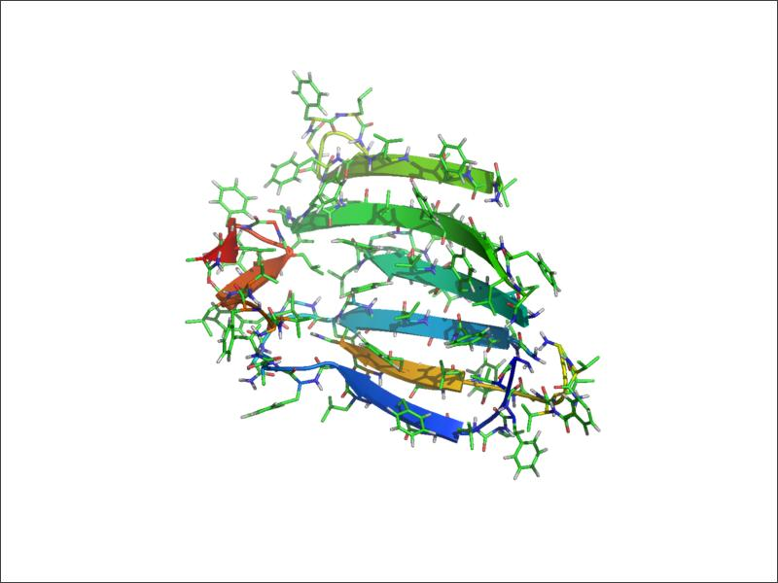
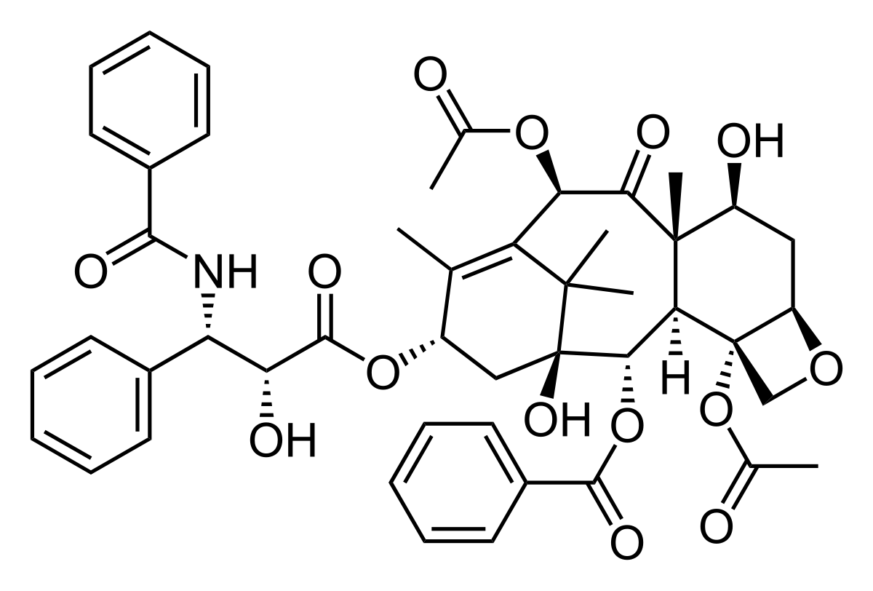
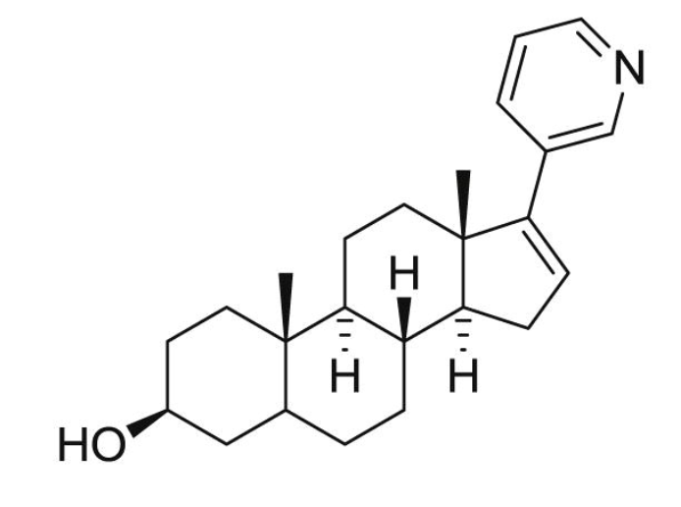

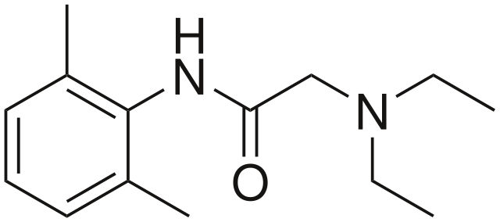
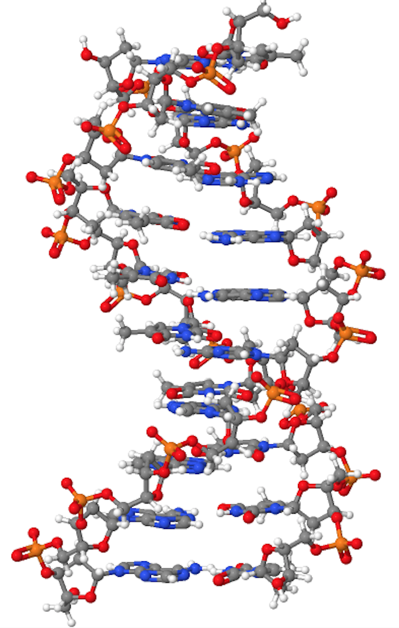
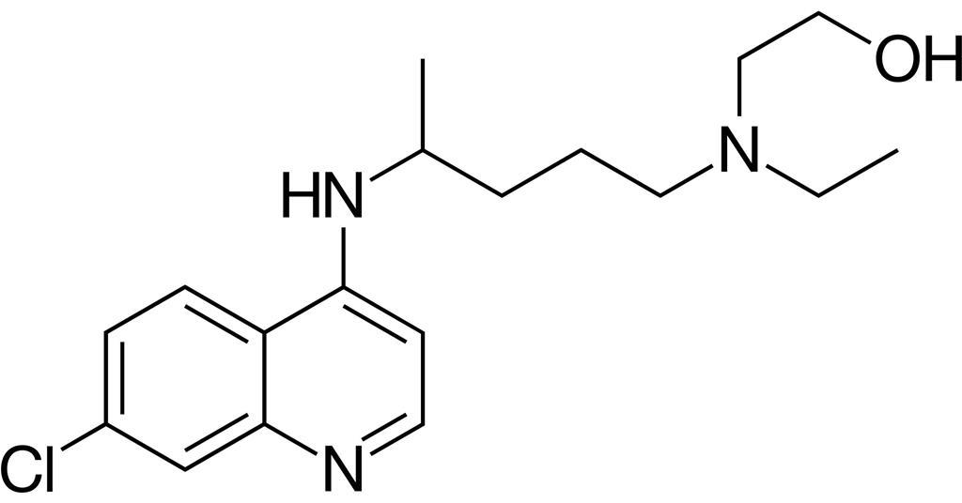
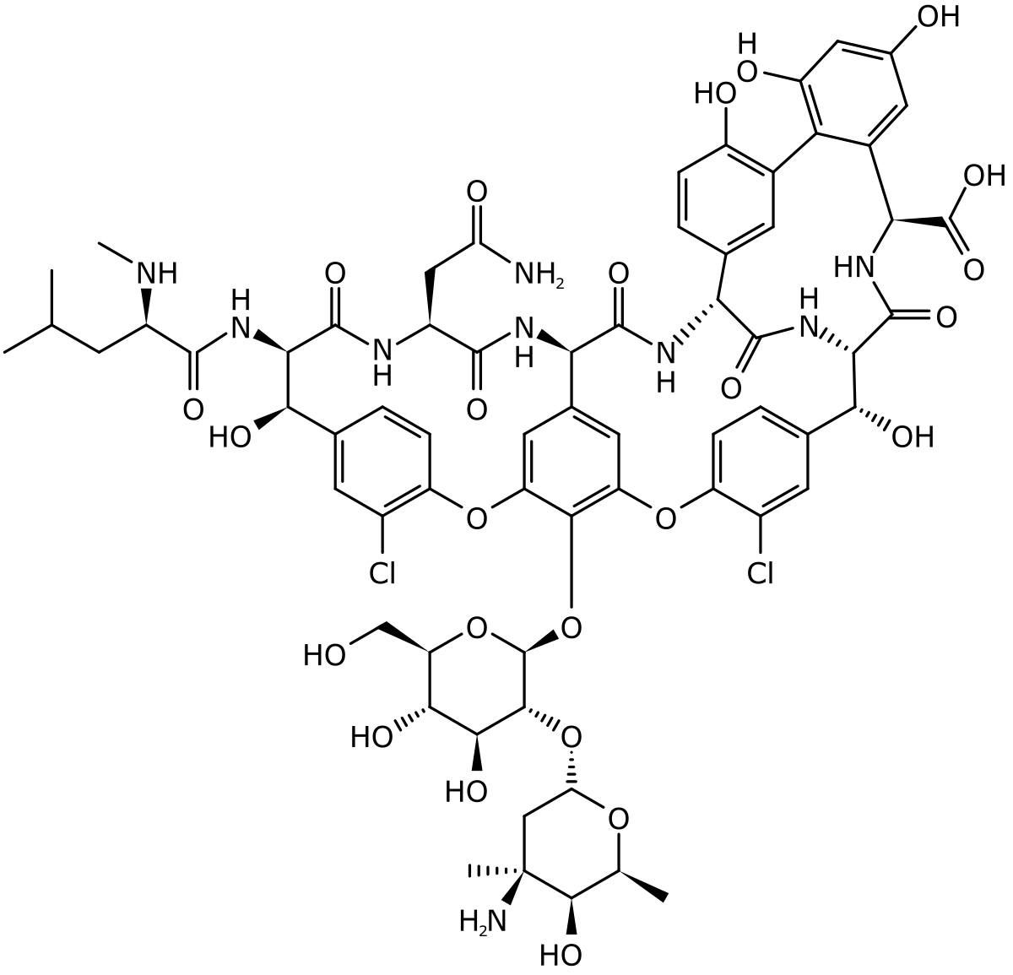
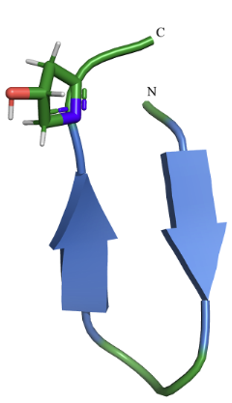
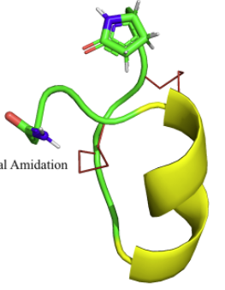
Generalised Force Fields
Proteins
Drugs
50,000 ligands
ChEMBL database
DNA
2.7 million bioactive compounds
230 million commercially available compounds
Non-standard Amino Acids
Lipids

Slide 6
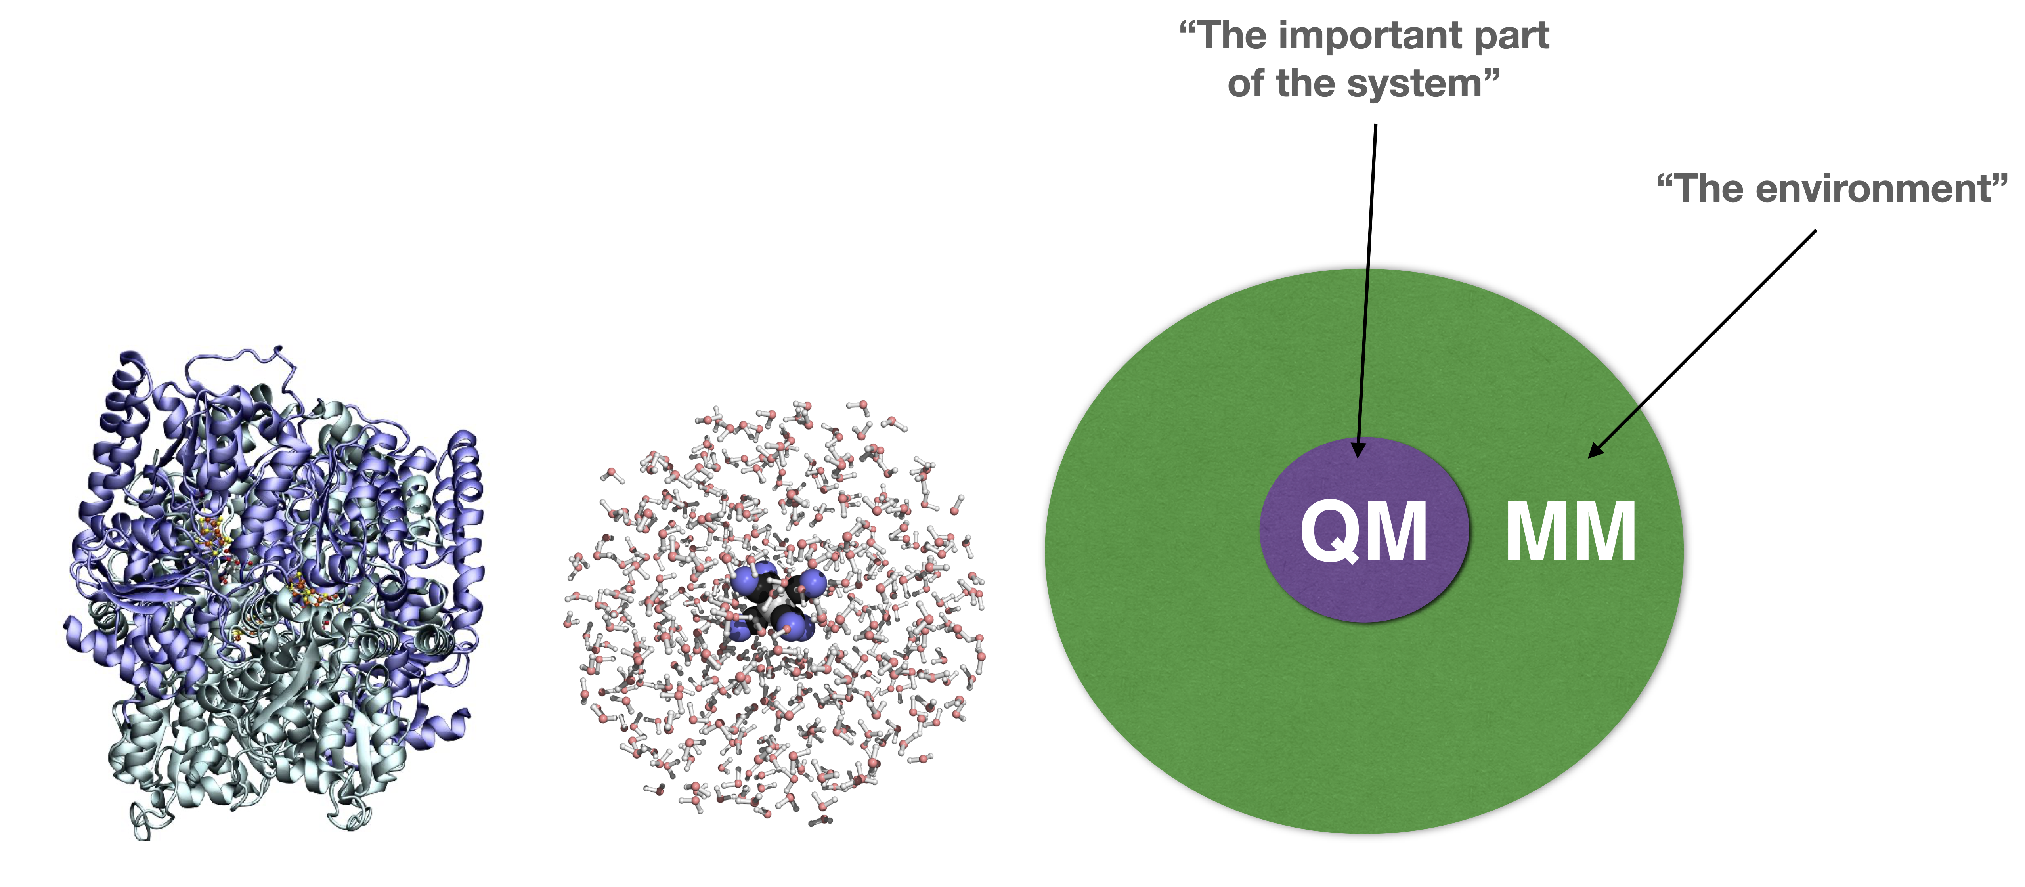
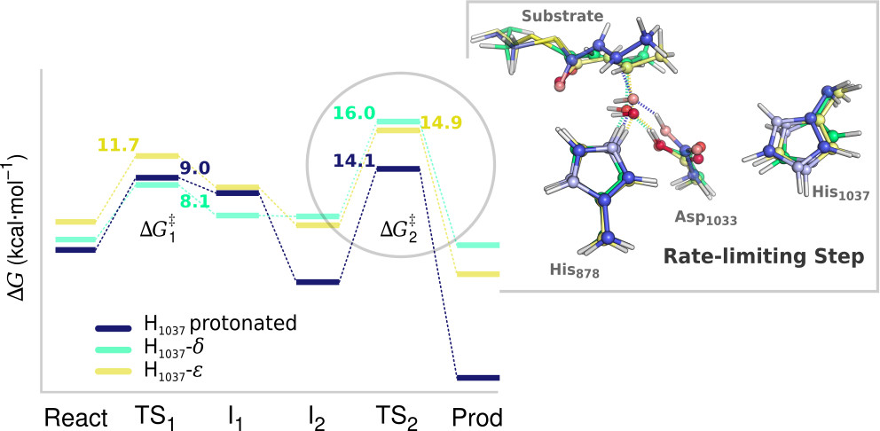

QM/MM Methods
Quantum Chemistry
Quantum Dynamics
Hartree–Fock (HF)
Density functional theory (DFT)
Møller–Plesset perturbation theory
MP2, MP3, etc.
Coupled Cluster
CCSD, CCSD[T], etc.

Slide 7
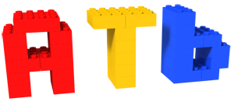
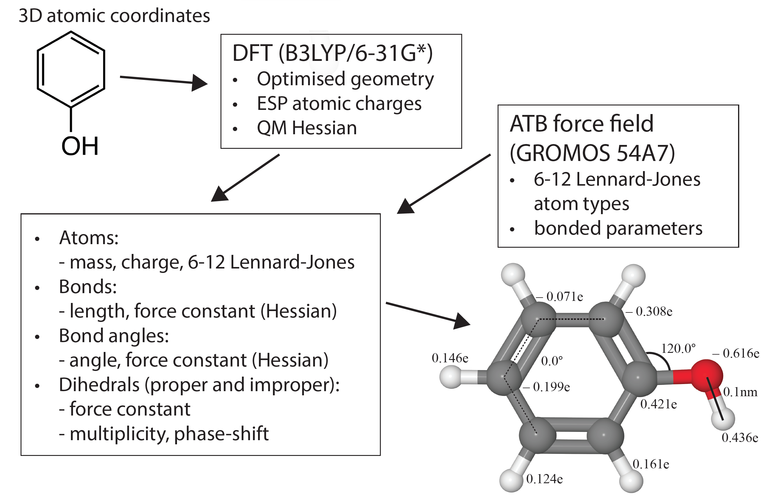
atb.uq.edu.au
ATB Version 3.0
1,150,000 submitted molecules
27,000 registered users
7 commercial customer
Output Formats
Molecular dynamics:
GROMOS, GROMACS,
LAMMPS, AMBER
X-ray refinement:
CNS, Phenix, CCP4, Refmac5
NMR refinement:
CYANA, CNS
Stroet M, Caron B, Visscher K, Geerke D, Malde AK, Mark AE, 2018 J Chem Theory Comput 14, 5834-5845

Slide 8
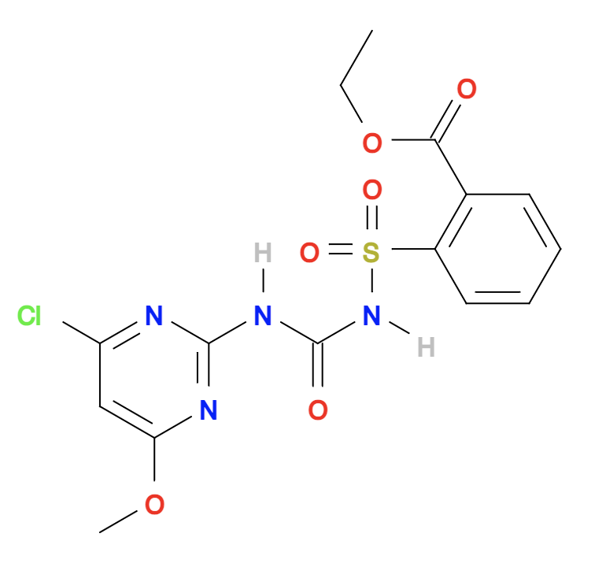
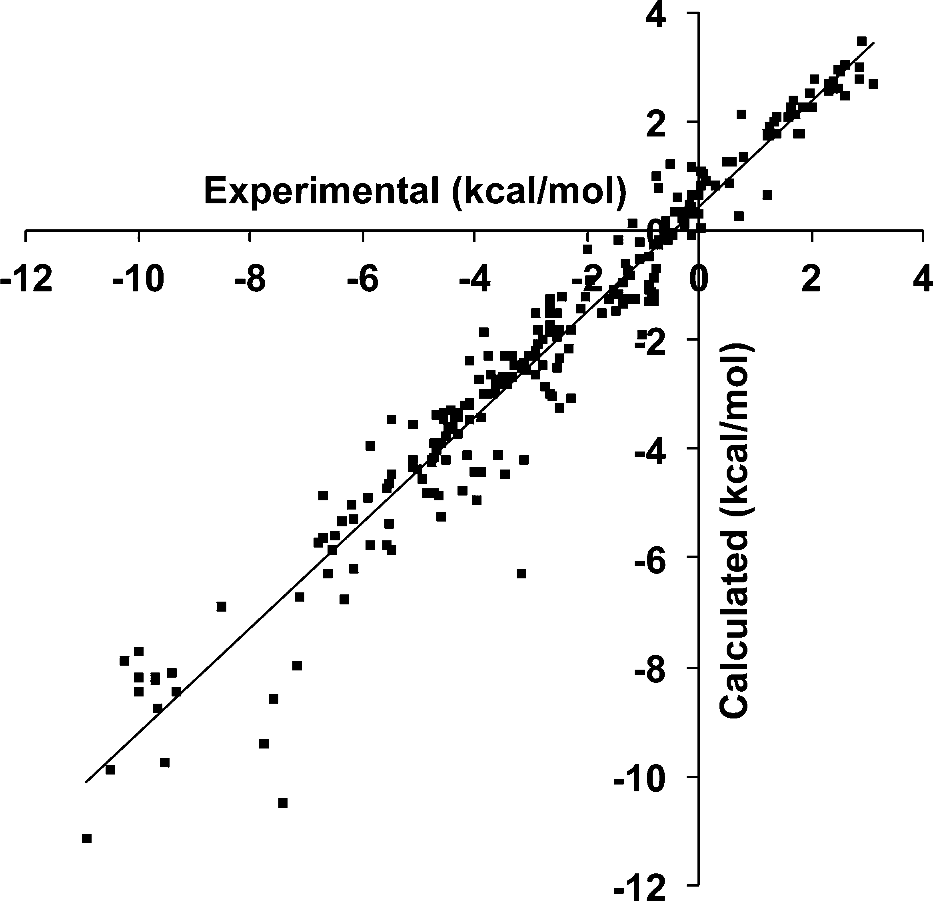
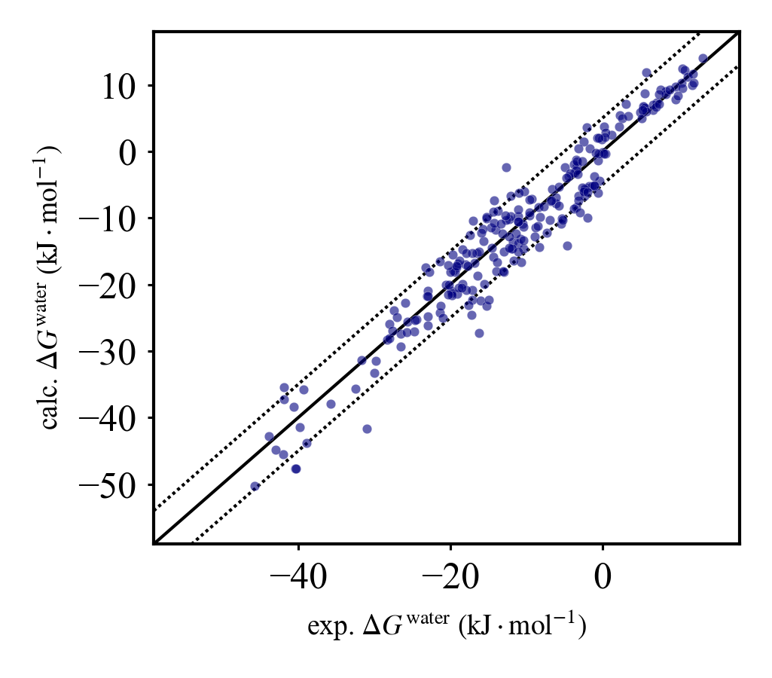
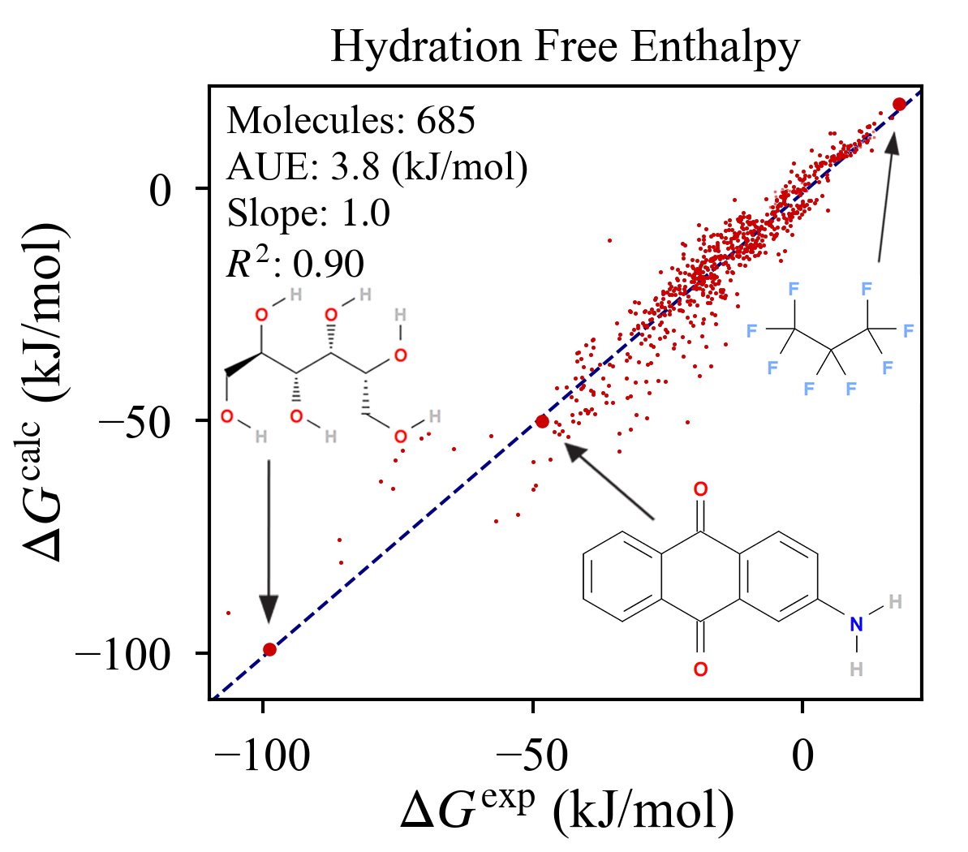
Solvation Free Energy in Water
force field | N | AUE (kJ·mol⁻¹) | RMSE (kJ·mol⁻¹) | AE (kJ·mol⁻¹) | slope | intercept (kJ·mol⁻¹) | R²
ATB3.0 | 239 | 2.7 | 3.4 | −0.4 | 1.0 | –0.3 | 0.93
OPLS3 | 239 | 3.0 | 3.6 | - | - | - | -
ATB3.0 | 685 | 3.8 | 5.5 | –1.0 | 1.0 | –1.0 | 0.90
OPLS3
ATB3.0
Stroet M, Caron B, Visscher K, Geerke D, Malde AK, Mark AE, 2018 J Chem Theory Comput 14, 5834-5845

Slide 9
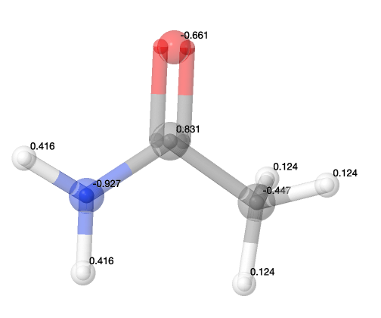
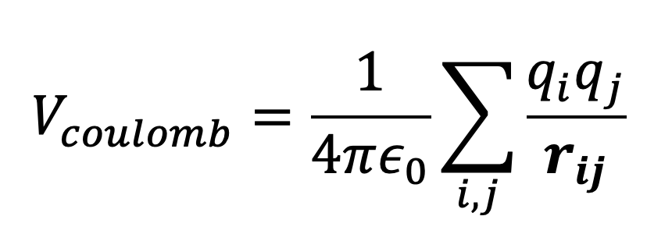
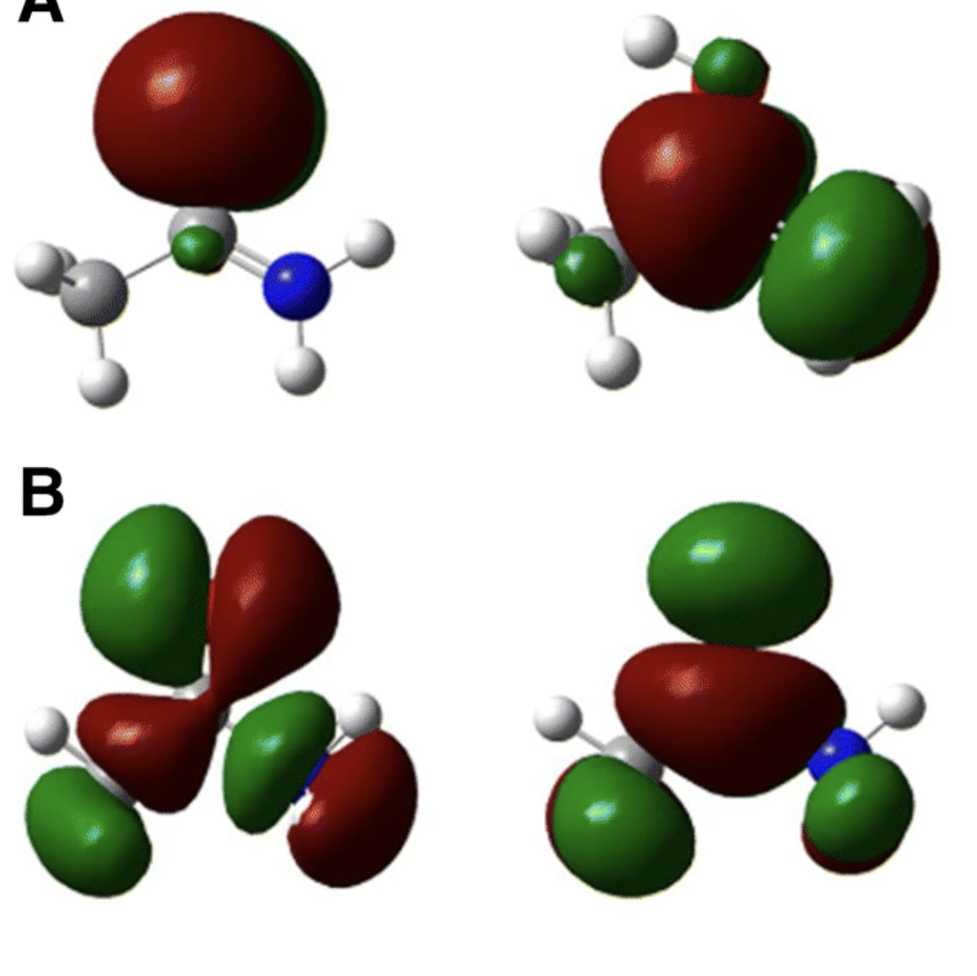
Electrostatic Interactions: Coulomb Potential

Slide 10
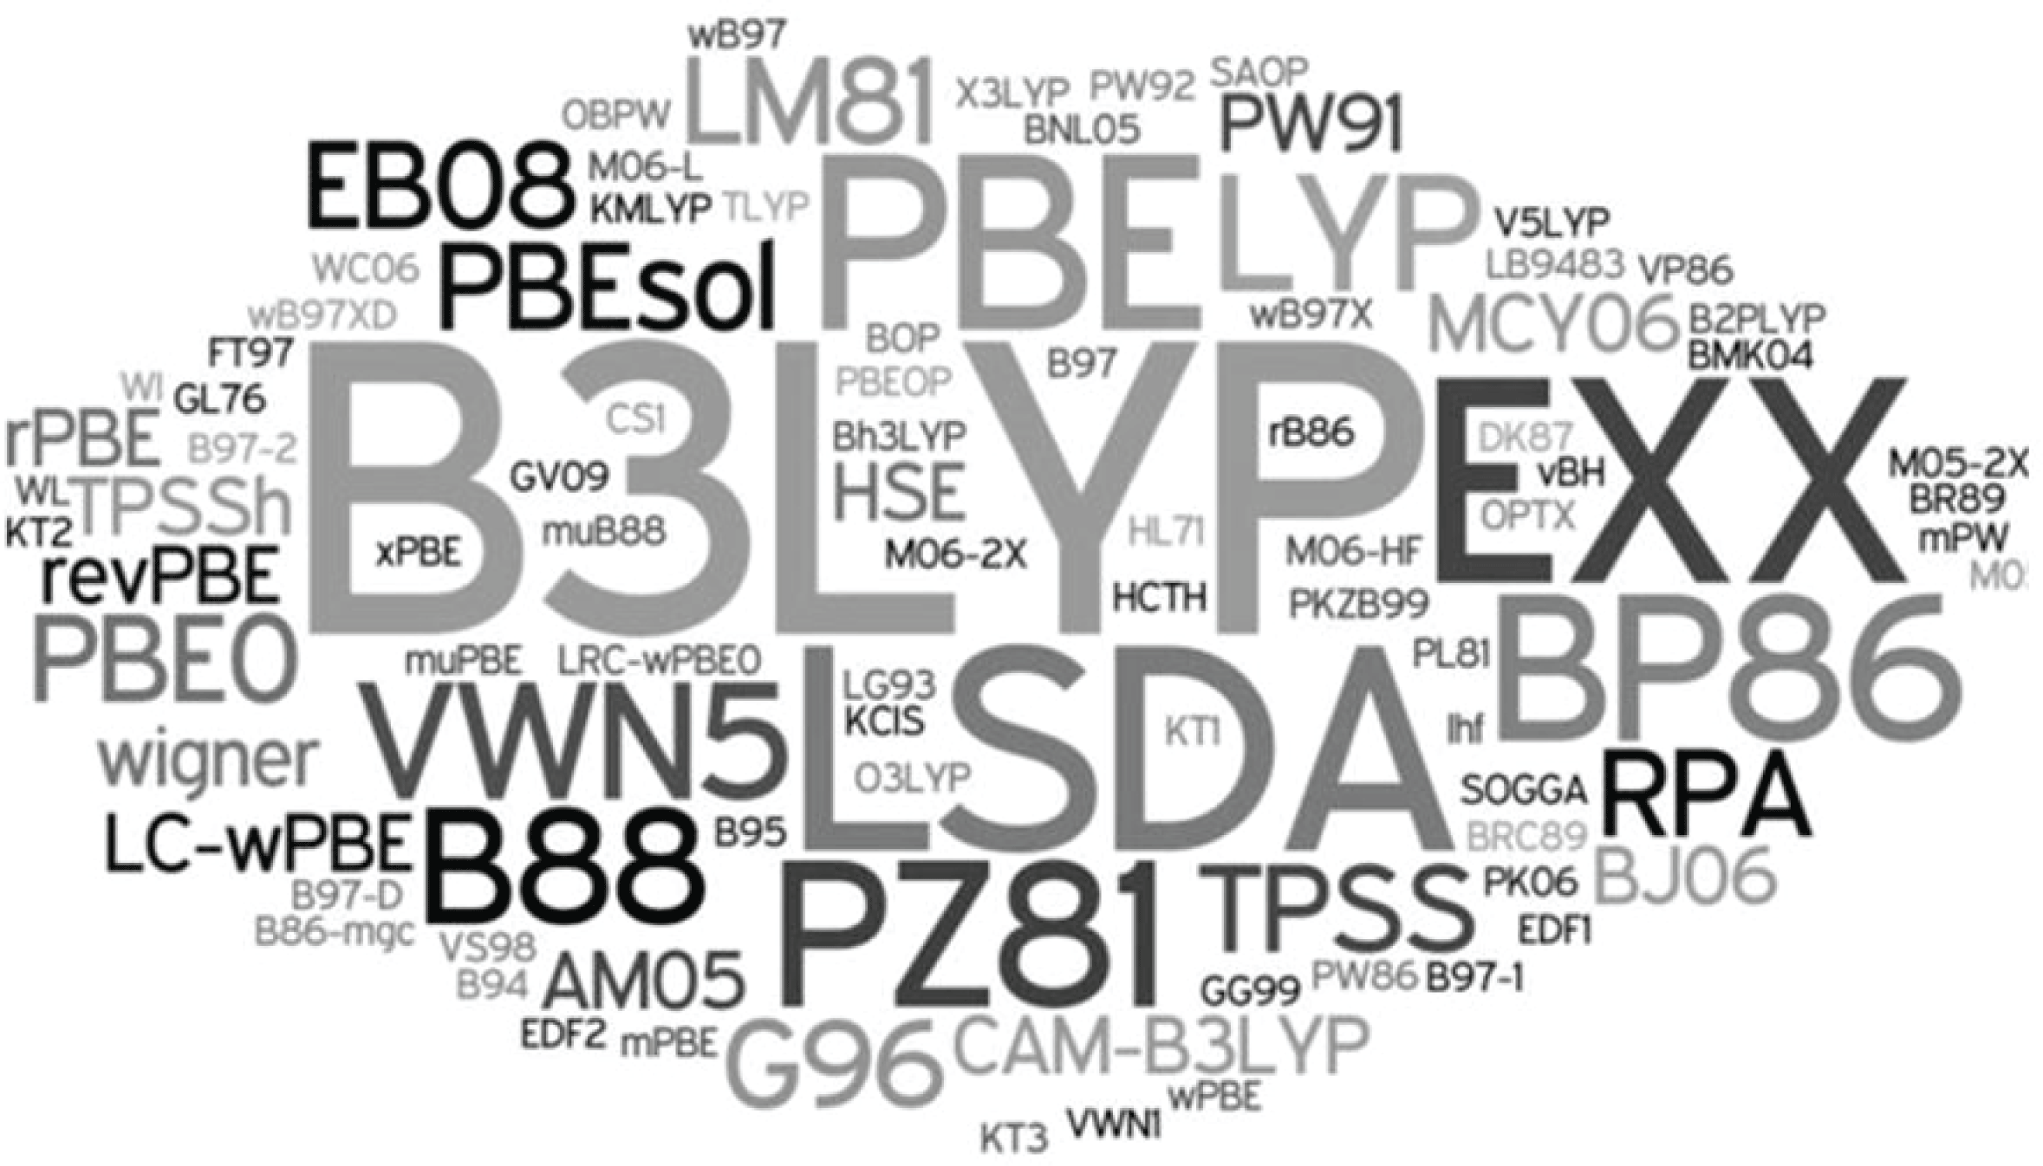
Coulomb Partial Charge Fitting
Partitioning/population methods | Fitting to Electric Fields
Mulliken population analysis Lowdin distribution analysis Hirshfeld partitioning Natural Population Analysis (NPA) Atoms In Molecules (AIM) | Electrostatic Potential (ESP) fitting Restrained Electrostatic Potential (RESP) fitting
AM1 populations with additive Bond Charge Corrections (AM1-BCC)
Levels of Theory
DFT Functionals
Basis Set
Hartree–Fock (HF)
STO-3G
6-31G(d)
6-31G(d,p)
cc-pVTZ
cc-pVQZ
aug-cc-pVTZ
cc-pCVTZ
D95
Def2-TZVP
Density functional theory (DFT)
Møller–Plesset perturbation theory
MP2, MP3, etc.
Coupled Cluster
CCSD, CCSD[T], etc.

Slide 11
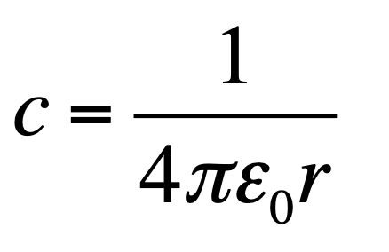
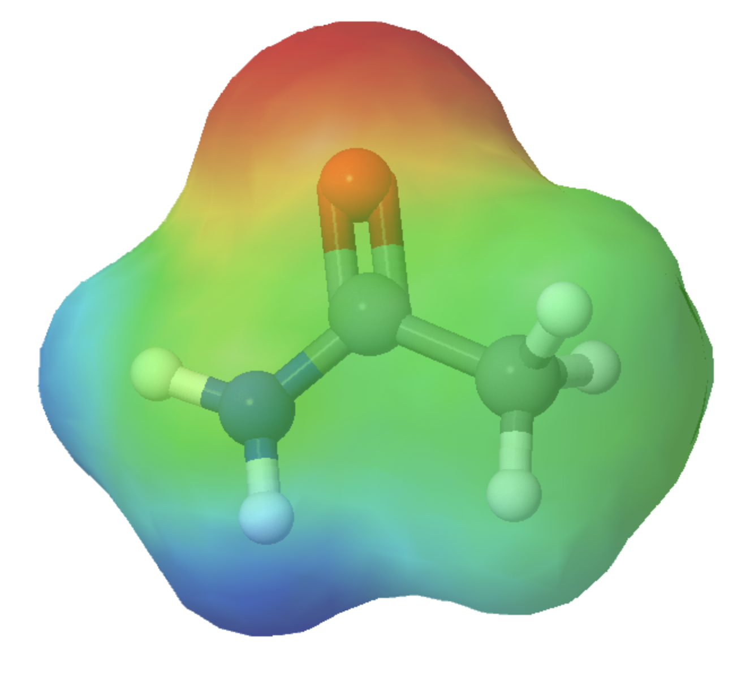
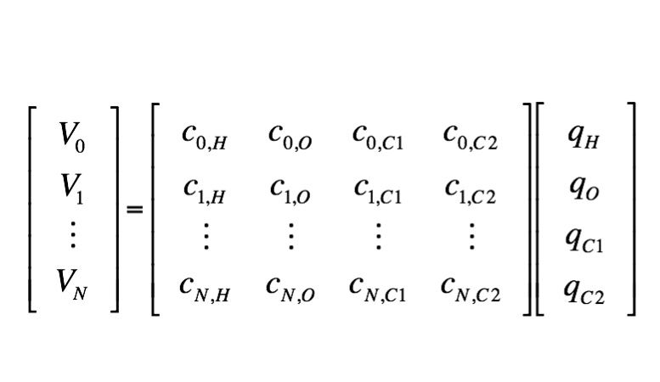
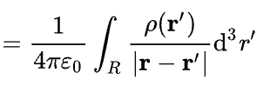

Electrostatic Potential Fitting
Electronic structure (Quantum Chemistry)
Electrostatic Potential (ESP)
$$q={\left(A^{T}A\right)}^{−1}A^{T}v$$
Levels of Theory
DFT Functionals
Basis Set
Hartree–Fock (HF)
STO-3G
6-31G(d)
6-31G(d,p)
cc-pVTZ
cc-pVQZ
aug-cc-pVTZ
cc-pCVTZ
D95
Def2-TZVP
Density functional theory (DFT)
Møller–Plesset perturbation theory
MP2, MP3, etc.
Coupled Cluster
CCSD, CCSD[T], etc.

Slide 12
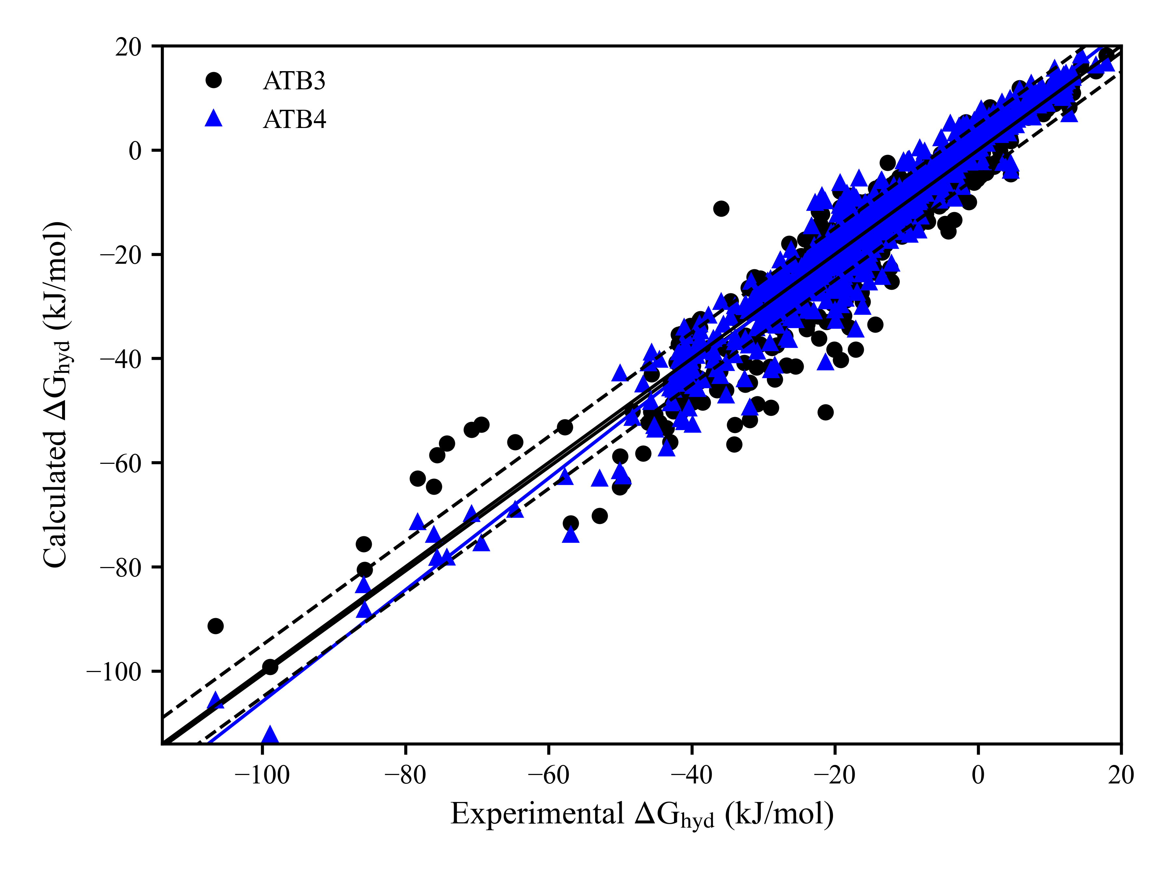
Solvation Free Energy in Water
Force Field | N | AUE (kJ·mol⁻¹) | RMSE (kJ·mol⁻¹) | AE (kJ·mol⁻¹) | slope | intercept (kJ·mol⁻¹) | R²
ATB3.0 | 685 | 3.8 | 5.5 | –1.0 | 1.0 | –1.0 | 0.90
ATB4.0 | 707 | 3.2 | 4.37 | 0.2 | 1.08 | 1.4 | 0.95
ATB3.0 - B3LYP/6-31Gd (PCM¹ water)
ATB4.0 - ωB97X/6-31Gd (SMD² water)
¹ Mennucci, et al. The Journal of Physical Chemistry A 106 (2002), 106, 6102
² Marenich, et al. The Journal of Physical Chemistry B (2009), 113, 6378

Slide 13
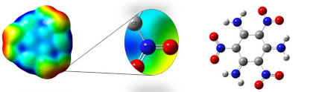
Intricate Electrostatic Structure
RMS Deviation 2.8 kJ/mol
RMS Deviations of 10-20 kJ/mol

Slide 14
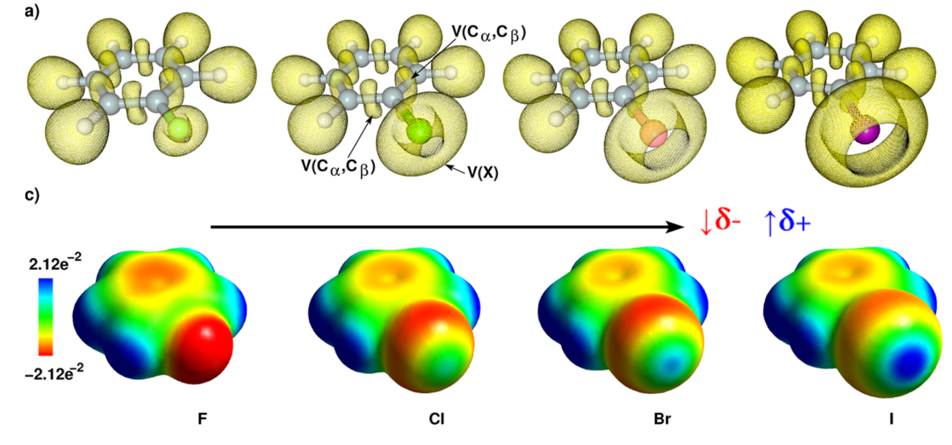
Halogen Electrostatic Structure

Slide 15
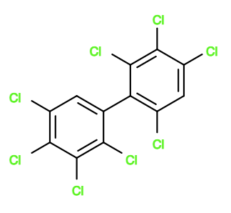
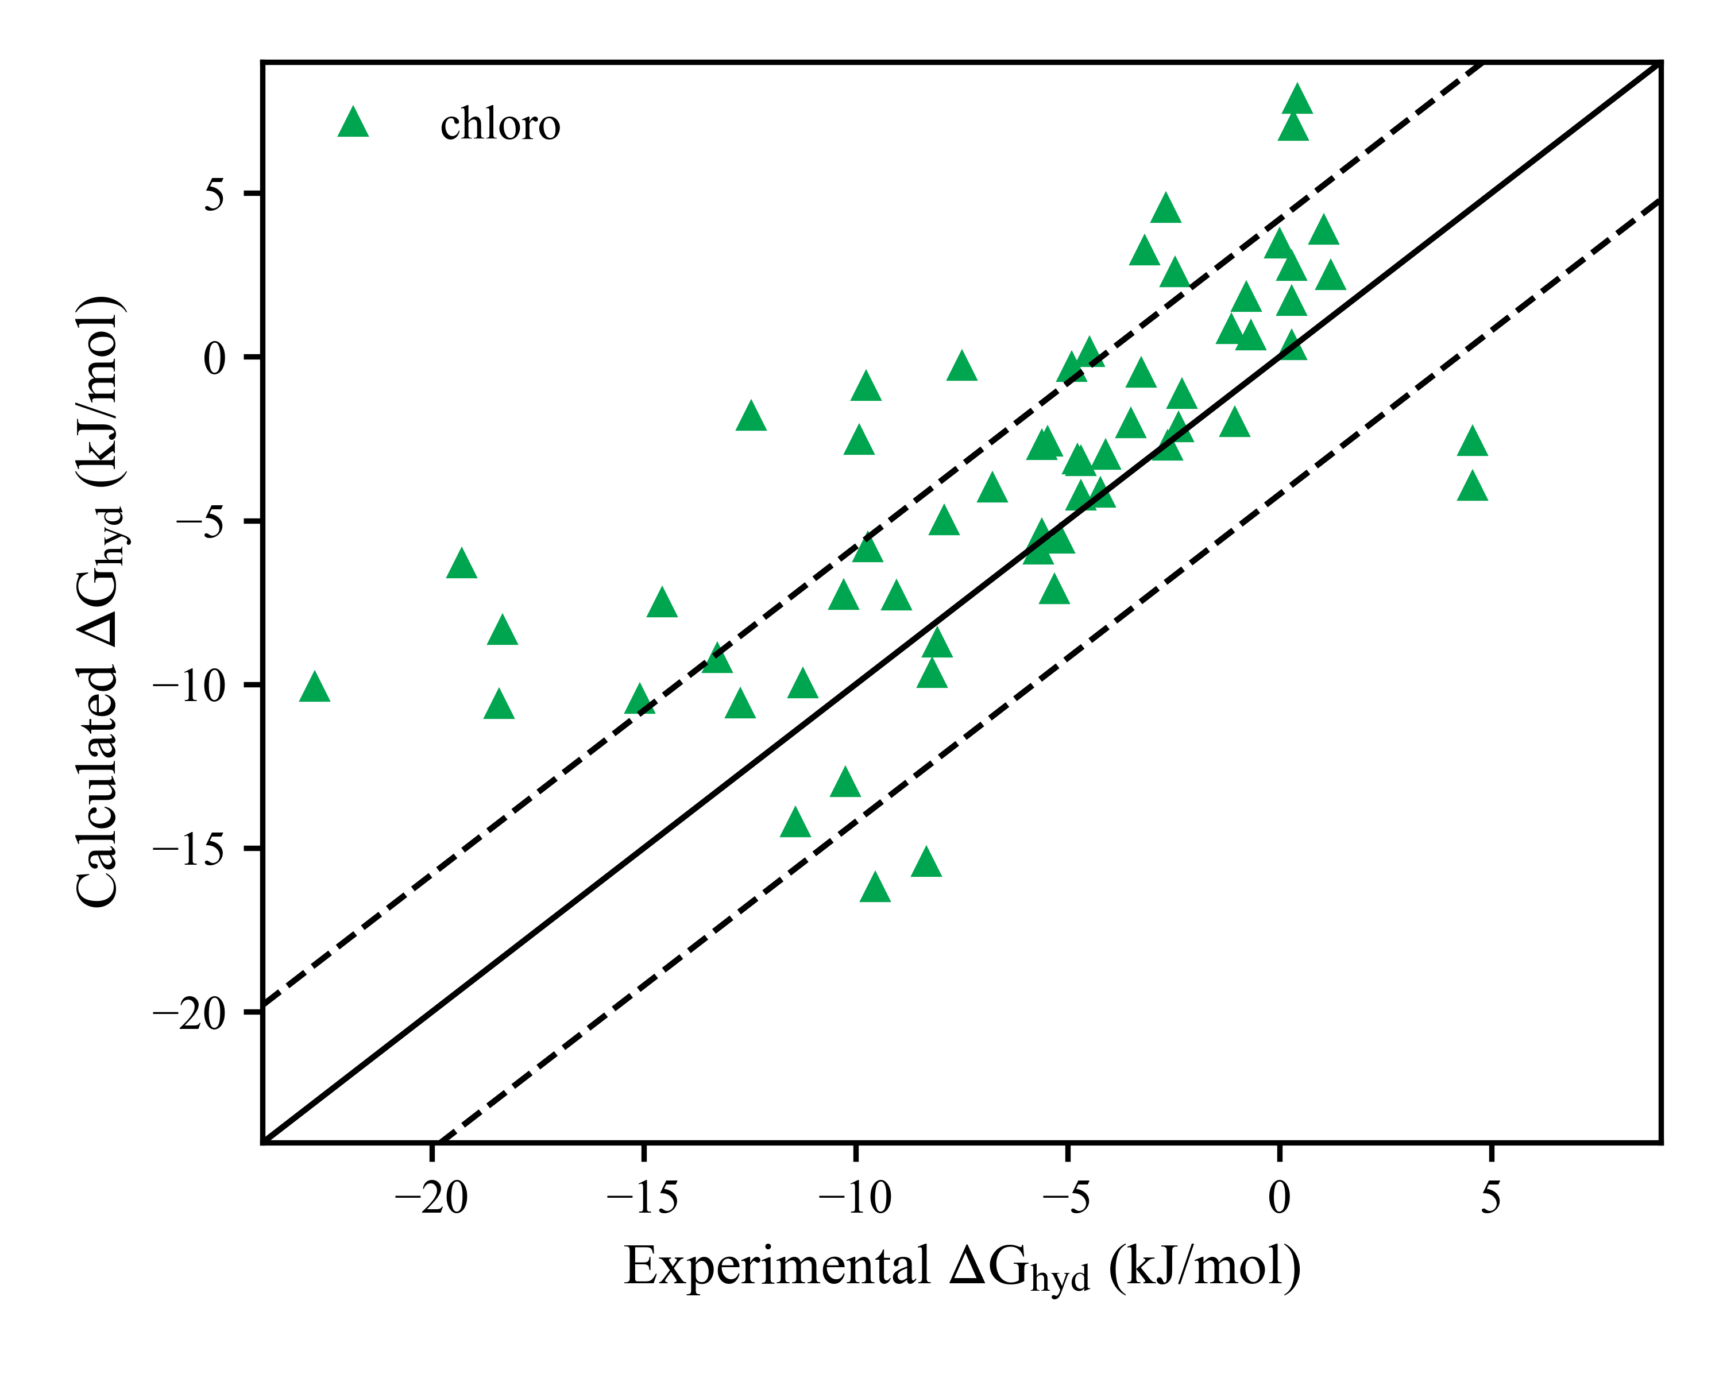
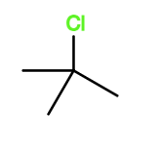
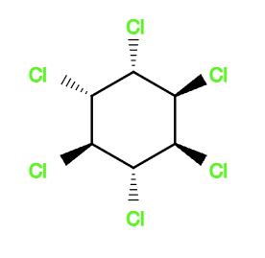
Solvation Free Energy in Water
Force Field | N | AUE (kJ·mol⁻¹) | RMSE (kJ·mol⁻¹) | AE (kJ·mol⁻¹) | slope | R²
ATB3.0 | 685 | 3.8 | 5.5 | –1.0 | 1.0 | 0.90
ATB4.0 | 707 | 3.2 | 4.37 | 0.2 | 1.08 | 0.95
Chloro | 59 | 3.9 | 5.1 | 2.5 | 0.64 | 0.5
Abhay Sharma

Slide 16
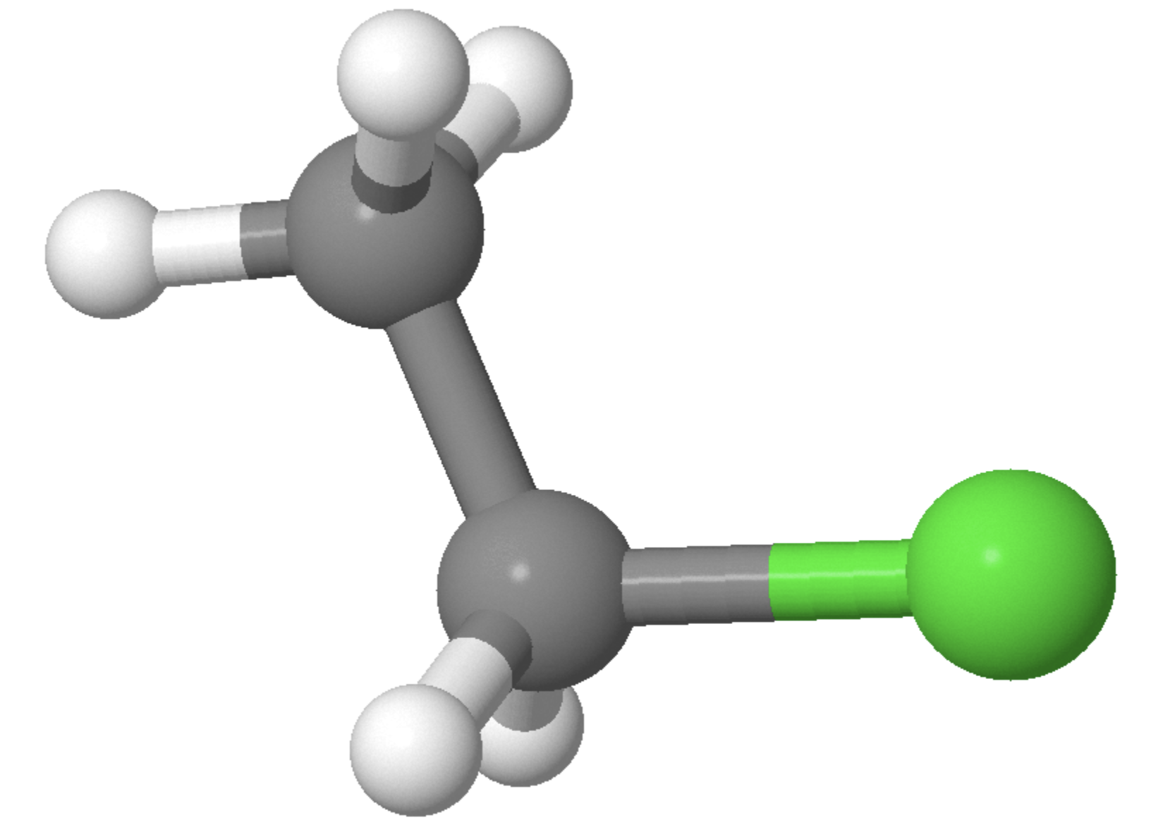
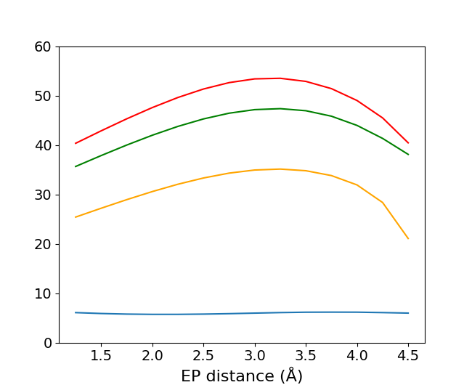
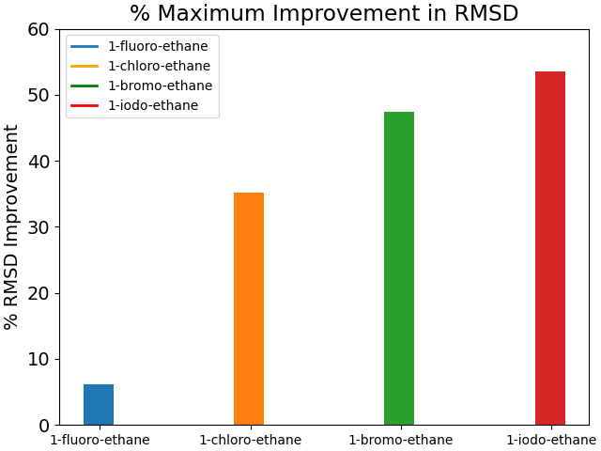
Halo-ethane Charge Fitting Improvement
Extra Point (EP)
ωB97X/6-31Gd
I
Br
Cl
F
Abhay Sharma

Slide 17


What I can do
Halo-ethane Charge Fitting Improvement
Extra Point (EP)
ωB97X
B3LYP
Abhay Sharma

Slide 18






Metal Complexes
Chlorophyll - Mg(II)
Cisplatin - Pt(II)
Ir(ppy)2(acac) - Ir(III)
Plastocyanin - Cu(II)
Zinc Finger – Zn(II)
Hemoglobin - Fe(II)

Slide 19





Acknowledgements
MD Group
Prof Alan Mark
Abhay Sharma
Dr Zihan Zhou
Callum Macfarlane

